Slide 1
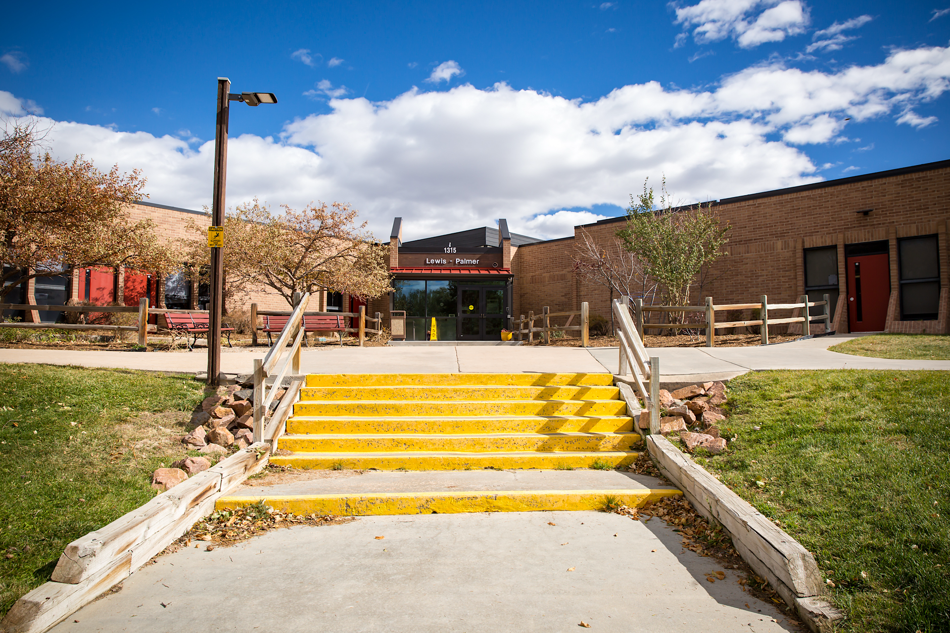
Becoming Digital Citizens
Safe Searching • Source Checking • Ethical Use
William Fonda • Lewis Palmer District 38 • 5th Grade

Slide 2

💡 What is a Digital Citizen?
Digital citizens make safe choices and protect their privacy online!
Sources: ISTE Standards for Students, Google Safety Center

Slide 3
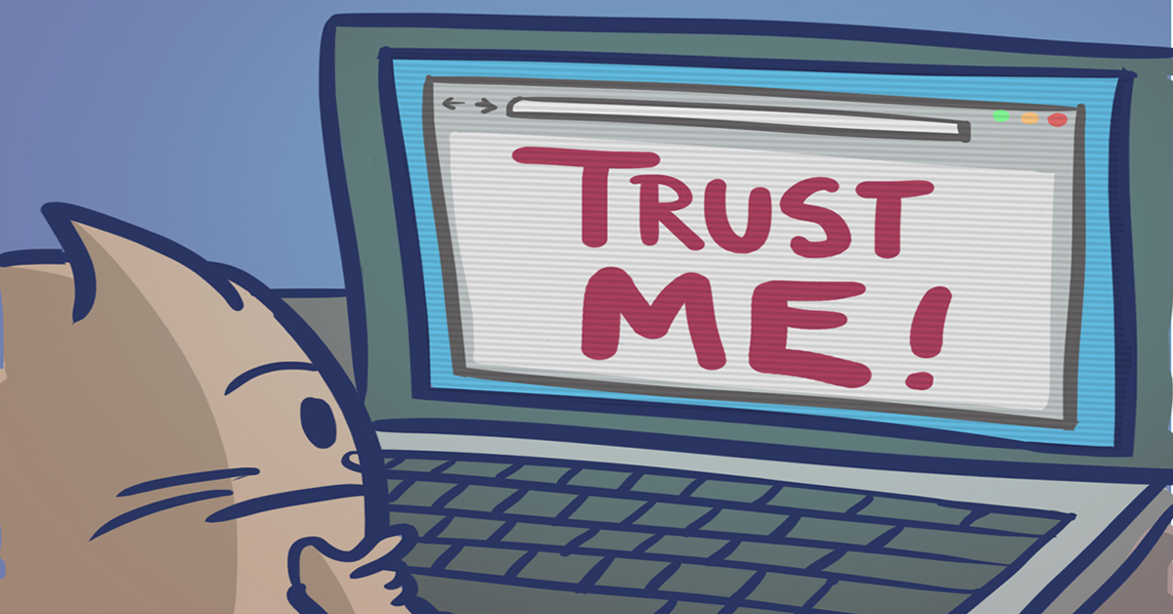
The TRAAP Test
Use the TRAAP Test to check if a website is reliable:
⏰ Timeliness - Is it up-to-date?
🎯 Relevance - Does it match my topic?
👤 Authority - Who wrote it?
✓ Accuracy - Can I verify this elsewhere?
🎭 Purpose - Is the website trying to inform or sell?
Source: California State University, Chico. (n.d.). Evaluating Information – Applying the TRAAP Test. Meriam Library.

Slide 4

Evaluating Your Sources
Good researchers check their sources carefully!
Look for trusted websites (.edu, .gov, .org)
Check when information was published
Find out who wrote the information
Compare information across multiple sources
Sources: Johns Hopkins Library, Global Cognition Critical Thinking Resources

Slide 5

Citing Your Sources
Always give credit when you use information from a website!
What to include:
Author's name
Article title
Website name
Date you found it

Slide 6

Citation Example
Smith, Jane. "Rainforest Animals."
National Geographic Kids. Retrieved February 8, 2026,
from www.natgeokids.com
Sources: Johns Hopkins Library Citation Guide, ISTE Standards

Slide 7

Understanding Plagiarism
Plagiarism = Copying someone else's work and pretending it's yours
❌ Don't: Copy and paste from a website without giving credit

Slide 8
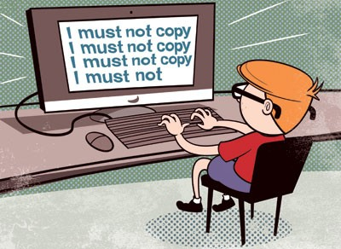
How to Avoid Plagiarism
✓ Do this instead:
Read and learn from the website
Write the information in your own words
Cite your source
Sources: ISTE Digital Citizenship Standards, Academic Integrity Resources

Slide 9

Remember
🔍 Search Safely
✓ Check Sources
📝 Give Credit

Slide 10
Questions?
Thank you for becoming better digital citizens!

