Slide 1
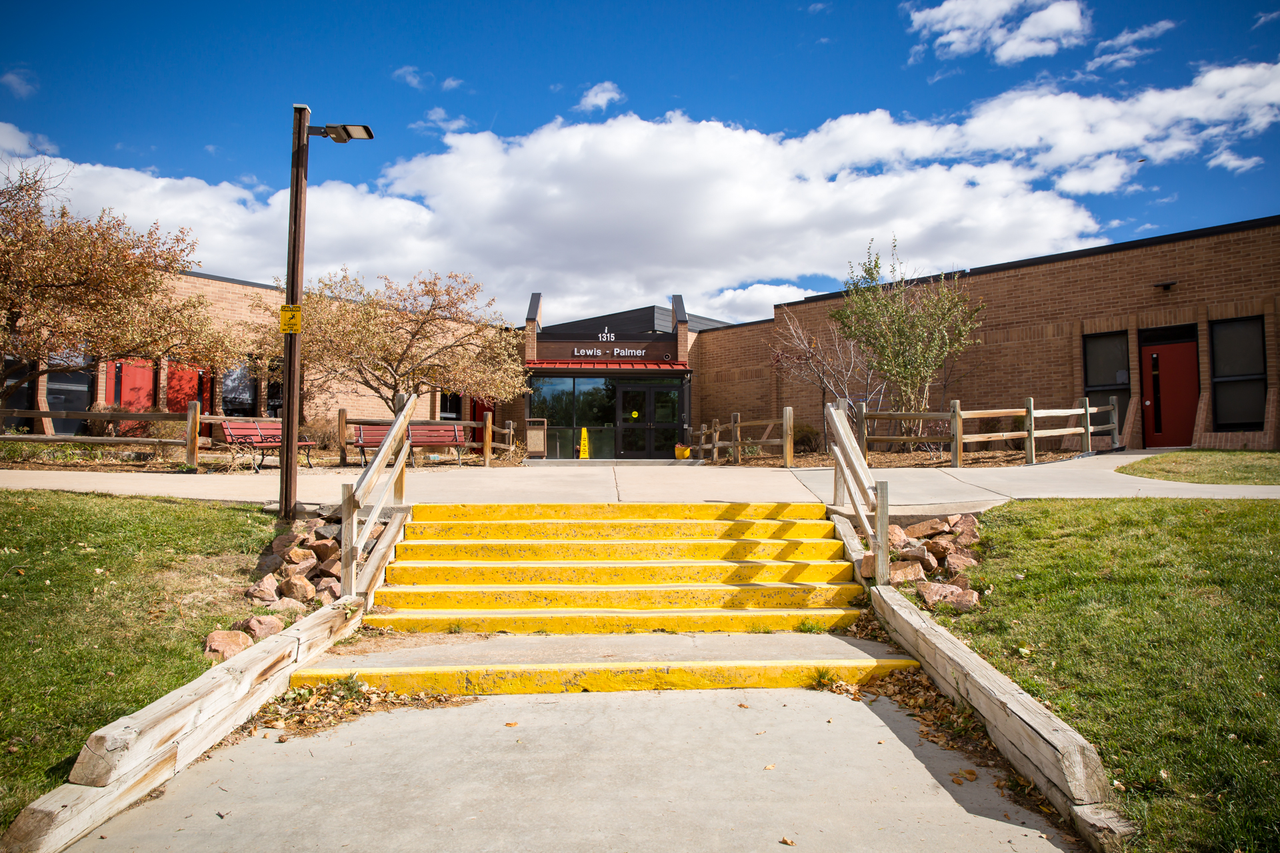
Technology Safety & Ethics
Proactive Strategies for Responsible Technology Use
Lewis Palmer District 38
William Fonda • February 2026

Slide 2
Why Cybersecurity Matters in K-12
Over 350 cyber incidents targeted K-12 schools from 2016-2018 (EdTech Magazine, 2018)
Incidents result in loss of instructional time and student data
Schools hold sensitive personal information vulnerable to theft
Proactive education reduces risk and builds digital citizenship

Slide 3
LPSD Technology Vision
Lewis Palmer District 38 leverages technology to engage, empower, and inspire lifelong learners as local, national, and global citizens.
Regular security audits and professional monitoring
Industry-standard security protocols
Data Privacy Addendums with all vendors

Slide 4
Challenge: Student Misuse of Technology
Potential Issues:
Accessing inappropriate content or bypassing filters
Cyberbullying or harmful online communication
Sharing passwords or personal information

Slide 5
Solutions: Building Responsible Users
Teach digital citizenship from day one
Establish clear expectations aligned with LPSD policies
Practice identifying safe vs. unsafe online behavior
Model appropriate technology use consistently

Slide 6
Challenge: Access & Infrastructure
Potential Issues:
Multiple students accessing network simultaneously
BYOD security vulnerabilities and inconsistent devices
Bandwidth limitations during peak usage

Slide 7
Solutions: Ensuring Equitable Access
Schedule high-bandwidth activities strategically
Provide clear BYOD guidelines and parent communication
Maintain updated device inventory and charging stations
Create offline backup activities for connectivity issues

Slide 8
Challenge: Technical Malfunctions
Common Problems:
Devices not connecting to network
Uncharged devices or dead batteries
Forgotten passwords and login issues

Slide 9
Solutions: Technical Preparedness
Teach students device care and charging routines
Create password storage system (secure physical location)
Have backup devices available for immediate use
Troubleshoot common issues before lesson begins

Slide 10
Challenge: Blocked Content & CIPA
Potential Issues:
Educational resources blocked by school firewall
Uncertainty about CIPA compliance for new tools
Inconsistent access to approved materials

Slide 11
What is CIPA?
Children's Internet Protection Act requires schools to:
Block access to obscene or harmful content
Monitor student online activities
Implement internet safety policies

Slide 12
Solutions: Ensuring Material Access
Pre-test all websites and tools before lesson day
Submit vetted resources to LPSD IT for approval
Review LPSD's digital resources approved list
Maintain alternative resources if primary is blocked

Slide 13
Who Can Help: LPSD Support
Technology Services: (719) 757-1564
Instructional Technology: Contact building tech coordinator
IT Help Desk: For network and device issues
Administration: For student behavior concerns

Slide 14
Class Presentation: Digital Footprint & Password Safety
Building responsible digital citizens one lesson at a time

Slide 15
Lesson Objectives
Students will be able to:
Define digital footprint and explain permanence
Identify safe vs. unsafe online sharing practices
Create and protect strong passwords

Slide 16
What is a Digital Footprint?
Everything you post, share, or do online leaves a permanent trail that others can see.
Key Message: Think before you click—once it's online, it's there forever!

Slide 17
Activity: Think Before You Share
Would you share this online?
Your full name and address
A photo of your family vacation
Mean comments about a classmate

Slide 18
Why Strong Passwords Matter
Weak passwords make it easy for hackers to access your information and pretend to be you online.
LPSD Tip: Never use the same password for everything!

Slide 19
Strong Password Tips
Use at least 8 characters with numbers and symbols
Avoid obvious choices like birthdays or pet names
Never share passwords with friends
Change passwords regularly

Slide 20
Being an Ethical Digital Citizen
Respect others online as you do in person
Report cyberbullying or inappropriate content
Protect your own and others' personal information
Use technology for learning and positive purposes

Slide 21
The Opportunity Ahead
Cybersecurity offers students meaningful career pathways with 3.5 million unfilled jobs projected by 2021 (EdTech Magazine, 2018).
Early education in digital safety prepares students to become ethical defenders of digital spaces.

Slide 22
Key Takeaways
Proactive teaching prevents technology problems
LPSD provides robust support and security infrastructure
Digital citizenship is essential at all grade levels
Preparation and backup plans ensure lesson success

Slide 23
References
EdTech Magazine. (2018, September). Schools can train the next batch of cybersecurity pros. EdTech Magazine. https://edtechmagazine.com/k12/article/2018/09/schools-can-train-next-batch-cybersecurity-pros-0
Lewis-Palmer School District 38. (n.d.). Data privacy and security. https://www.lewispalmer.org/page/data-privacy-and-security
NPR. (2024, March 10). Schools don't have great cybersecurity, and hackers have caught on. https://www.npr.org/2024/03/11/1236995412/cybersecurity-hackers-schools-ransomware
Lewis-Palmer School District 38. (n.d.). Information technology services. https://www.lewispalmer.org/page/technology
THE Journal. (2017, March 31). Ed tech strategies publishes K-12 cyber incident map. THE Journal. https://thejournal.com/articles/2017/03/31/ed-tech-strategies-publishes-k12-cyber-incident-map.aspx

Slide 24
Thank You!
Questions or Feedback?
Let's work together to build safe, responsible digital learners.

