Slide 1
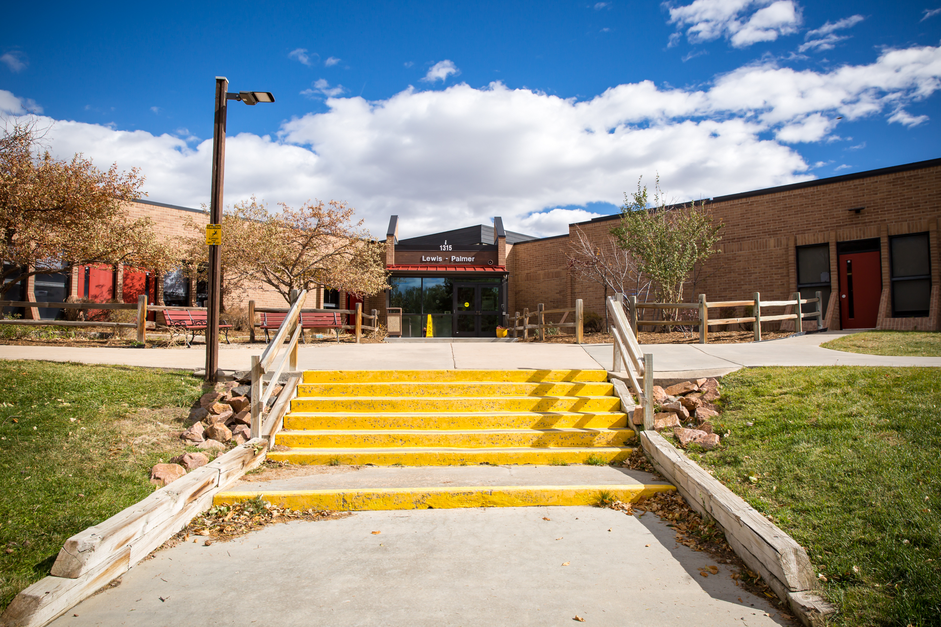
Being a Respectful Digital Citizen
Copyright, Fair Use, and Creative Commons
William Fonda - 5th Grade
Lewis Palmer School District 38

Slide 2
What is Copyright?
Copyright protects creative work like art, photos, music, videos, and writing
When someone creates something, it belongs to them, just like your artwork belongs to you!
You need permission to use someone else's work
Finding it online doesn't mean it's free to use
Source: Kelly, K. (2020, January 19). The educator's guide to copyright, fair use, and creative commons. The Edublogger. https://www.theedublogger.com/copyright-fair-use-and-creative-commons/

Slide 3
What is Fair Use?
Fair use lets you use small parts of someone's work for school projects
Example: Quoting a few sentences from a book in your report
Rules: Must be for learning, use only a small amount, give credit
Always cite your sources!
Sources: Kelly, K. (2020); Copyright Alliance. (n.d.). Copyright law explained. http://copyrightalliance.org/education/copyright-law-explained/

Slide 4
Creative Commons: Sharing Made Easy!
Some creators want to share their work freely with special licenses.
Creative Commons licenses tell you how you can use something
Look for CC licenses when searching for images or music
Always give credit using TASL: Title, Author, Source, License
Source: Creative Commons. (n.d.). Recommended practices for attribution. https://wiki.creativecommons.org/wiki/Recommended_practices_for_attribution

Slide 5
5 Rules to Remember
Ask permission or find free alternatives
Give credit to creators, cite your sources!
Your work is protected too, you're a creator!
Use trusted sites for free resources
Be respectful and ethical online!

